Slide 1
Unit 3:
AT HOME
B. Hoa’s family (B1, B2, B3, B4)

Slide 2
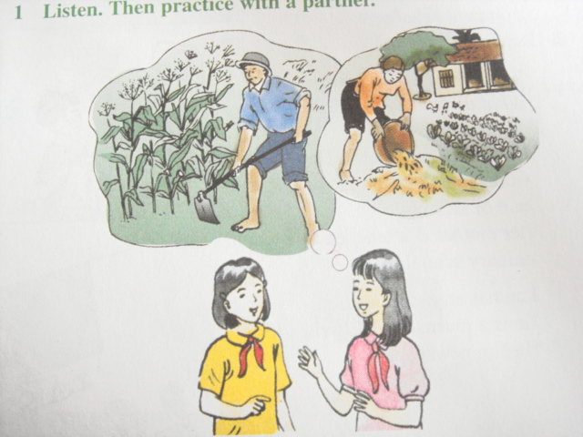
Unit 3: AT HOME
B. Hoa’s family (B1, B2, B3, B4)
WARM UP
How old is Hoa?
What does she do?
Who does she live with?
Where is Hoa from?
Lan
Hoa

Slide 3
Unit 3: AT HOME
B. Hoa’s family (B1, B2, B3, B4)
B1. Listen. Then practice with a partner.
- to grow (v):
trồng
- to raise cattle (v):
nuôi gia súc
- to work hard (v):
làm việc chăm chỉ
- a job (n):
công việc
- a housewife (n):
người nội trợ
- farm (n):
nông trại
- journalist (n):
nhà báo
- newspaper (n)
tạp chí

Slide 4
Unit 3: AT HOME
B. Hoa’s family (B1, B2, B3, B4)
B1. Listen. Then practice with a partner.
- sick (n)
bệnh
- primary school (n)
trường tiểu học
- to take care of (v)
chăm sóc

Slide 5
Unit 3: AT HOME
B. Hoa’s family (B1, B2, B3, B4)
B1. Listen. Then practice with a partner.
 | Job | Do what | Where to work
Hoa | Student | Learning | School
Father
Mother
Younger sister | student
grows vegetables & raises cattle
farmer
on farm
Does housework & helps on the farm
housewife
at home
learning
School

Slide 6
Unit 3: AT HOME
B. Hoa’s family (B1, B2, B3, B4)
B1. Listen. Then practice with a partner.
1. What’s does Hoa’s father do?
He is a farmer
2. Where does he work?
He works on the farm
3. What is her mother’s job?
She is a housewife
4. What does she do every day?
She does housework and helps on the farm
5. Are they happy?
Yes, they are
6. How old is hoa’s sister?
She is 8

Slide 7
Unit 3: AT HOME
B. Hoa’s family (B1, B2, B3, B4)
B1. Listen. Then practice with a partner.
Recalling
Hoa’s father is a farmer, he grows vegetables and raises cattle.
Hoa’s mother is a housewife, she does housework and helps on the farm
- Hoa’s younger sister is a student, she is only 8.

Slide 8
Unit 3: AT HOME
B. Hoa’s family (B1, B2, B3, B4)
B2. Read: * T/F prediction
T
1. Lan’s father takes care of sick people ……
F
2. He works in a school ……
F
3. Lan’s mother is a doctor ……
T
4. She teaches in a primary school ……
T
5. Lan’s brother is a journalist ……

Slide 9
Unit 3: AT HOME
B. Hoa’s family (B1, B2, B3, B4)
B2. Read
1. What does her father do?
He is a doctor
2. What does her mother do?
She is a teacher
3. What is her mother’s job?
She is a housewife
4. What does she do every day?
She does housework and helps on the farm
5. Are they happy?
Yes, they are
6. How old is hoa’s sister?
She is 8

Slide 10
Unit 3: AT HOME
B. Hoa’s family (B1, B2, B3, B4)
B2. Read
Recalling
Lan’s father is a doctor. He takes care of sick people. He works in a hospital.
Lan’s mother is a teacher. She teaches in a primary school.
- Lan’s brother is a journalist. He writes for a Ha Noi newspaper.

Slide 11
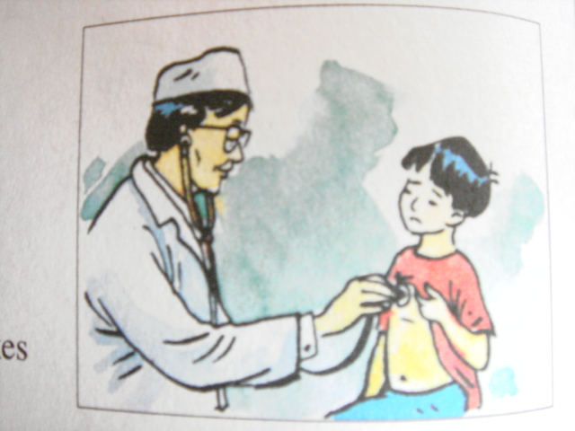
Unit 3: AT HOME
B. Hoa’s family (B1, B2, B3, B4)
Now practice with a partner:
a/ Talk about Lan’s family .
What does her father do?
Where does he work ?

Slide 12
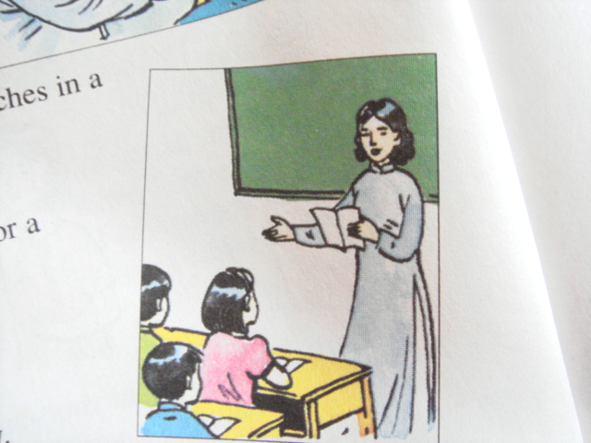

Unit 3: AT HOME
B. Hoa’s family (B1, B2, B3, B4)
- What does her mother do?
- Where does she work ?

Slide 13
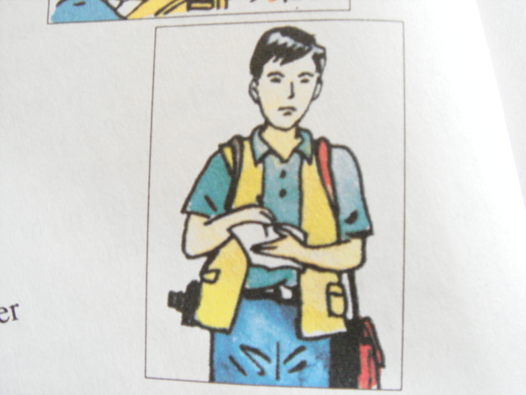
Unit 3: AT HOME
B. Hoa’s family (B1, B2, B3, B4)
- What does her brother do?
- Where does he work ?

Slide 14
Unit 3: AT HOME
B. Hoa’s family (B1, B2, B3, B4)
About you :
b/ Talk about your family :
- What does he/ she do ?
- Where does your father / mother/ brother / sister work ?

Slide 15
Unit 3: AT HOME
B. Hoa’s family (B1, B2, B3, B4)
SURVEY
NAME | AGE | JOB | PLACE TO WORK
Huan’s brother | 22 | Student | University
What’s your name?
How old are you?
What do you do?
Where do you work?

Slide 16
Unit 3: AT HOME
B. Hoa’s family (B1, B2, B3, B4)
B3. Match these half-sentences
1. A farmer a. write for a newspaper
2. A doctor b. works on a farm
3. A journalist c. teaches in a school
4. A teacher d. take care of sick children

Slide 17

Unit 3: AT HOME
B. Hoa’s family (B1, B2, B3, B4)
B4. Listen. Complete these form for three people on the tape
Tom
Susan
Name : ………………………..
Age : ……………………………
Job : ……………………………
Place of work: ………………
Name : ………………………..
Age : ……………………………
Job : ……………………………
Place of work: …………………
26
19
teacher
journalist
at a high school
for a magazine
Bill
Name : ………………………..
Age : ……………………………
Job : ……………………………
Place of work: ………………
20
nurse
in a hospital

Slide 18
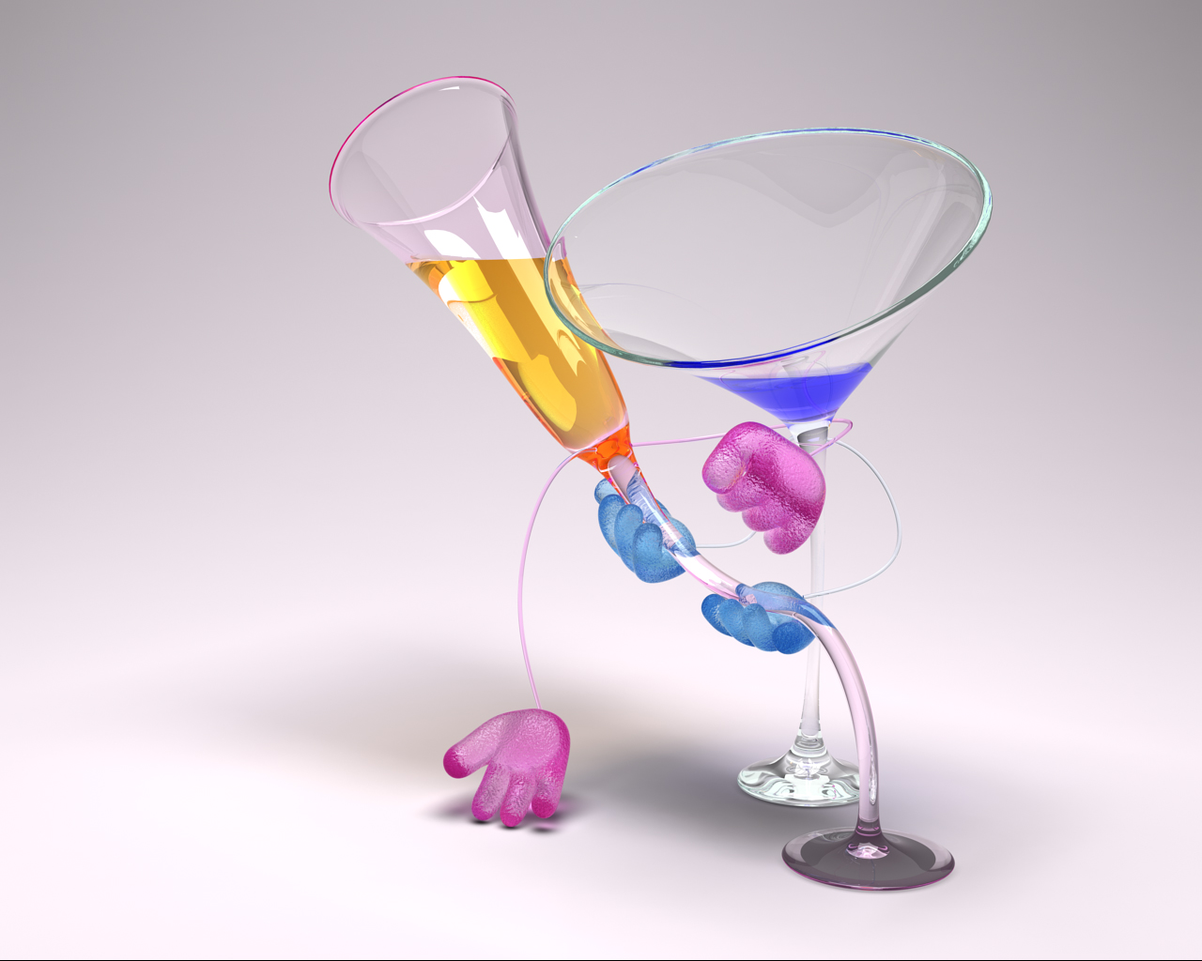
Unit 3: AT HOME
B. Hoa’s family (B1, B2, B3, B4)
Ask and answer the questions:
1. What do you do ?
2. Where do you work ?

Slide 19
Unit 3: AT HOME
B. Hoa’s family (B1, B2, B3, B4)
HOMEWORK
Learn vocabulary by heart.
Prepare new lesson unit 3: B5, B6

Slide 20
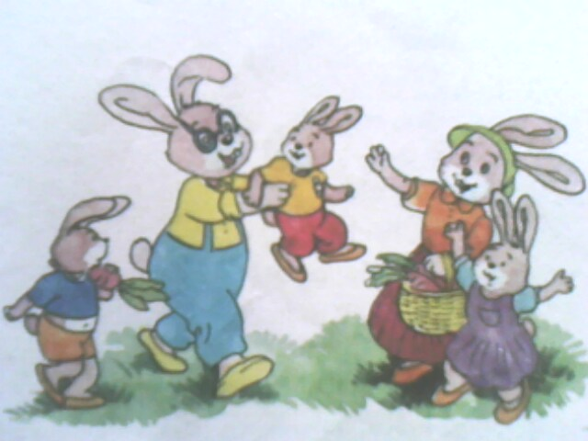
good bye- see you again
Hoàng Văn Phong – THCS Thanh Hòa
Buø Ñoáp – Bình Phöôùc

